Slide 1
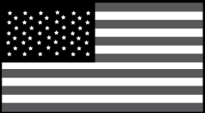
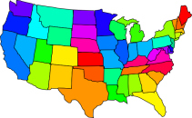
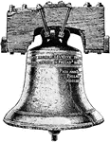
Name: ____________________________________________ Date:________________ Period:_________
North America map!
Physical and political
United States Political Map:
Label all 50 “nifty” United States, the states two-letter symbol (ex: Georgia=GA p. 140), and the capital of the state with a star. (color it the color on p.S28)
United States Physical Map: (p. S29 and 141)
Locate and label the following mountains by drawing
Alaska range, Mt. McKinley, Coast Range, Rocky Mountains, Mt. St. Helens, Appalachian Mountains
Locate and label the following bodies of water: (Color all water blue)
Bering Sea, Pacific Ocean, Colorado River, Missouri River, Mississippi River, Ohio River, Rio Grande, Gulf of Mexico, Atlantic Ocean, Chesapeake Bay
Great Lakes:
Lake Superior, Lake Huron, Lake Michigan, Lake Erie, Lake Ontario
Label the following Deserts: Death Valley, Mojave Desert
Label the following physical features: Great Basin, Interior Plains, Coastal Plains
Canada Political/Physical Map (p.189)
List all the provinces of Canada
Locate and label the following mountains by drawing
Mount Logan, Mackenzie Mountains, Rocky Mountains
Locate and label the following bodies of water: (color all water blue)
Hudson Bay, Hudson Strait, St. Lawrence River, Artic Ocean, Atlantic Ocean, Pacific Ocean, Labrador Sea
Label the Canadian Shield
Please draw in the following: Great Bear Lake, Yukon River, Lake Winnipeg

