Slide 1
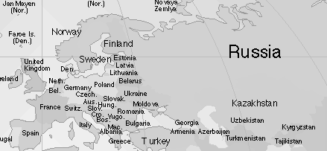
List some of the famous sites in each of the countries you visit.
List some of the most common foods in each of the countries.
Country or Place | Famous Sites
Country or Place | Food
Extra interesting facts about your places_________________________________________________________________________________ __________________________________________________________________________________________________________________________________________________________________________________________________________________________________
Map out your tour of Europe: Put a 1 next to your first stop, a 2 next to your second, etc.

