Slide 1
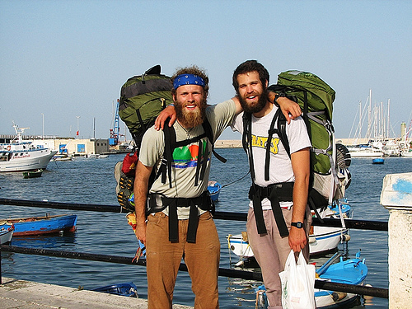
Virtual Backpacking Through Europe Project
Your photo here

Slide 2
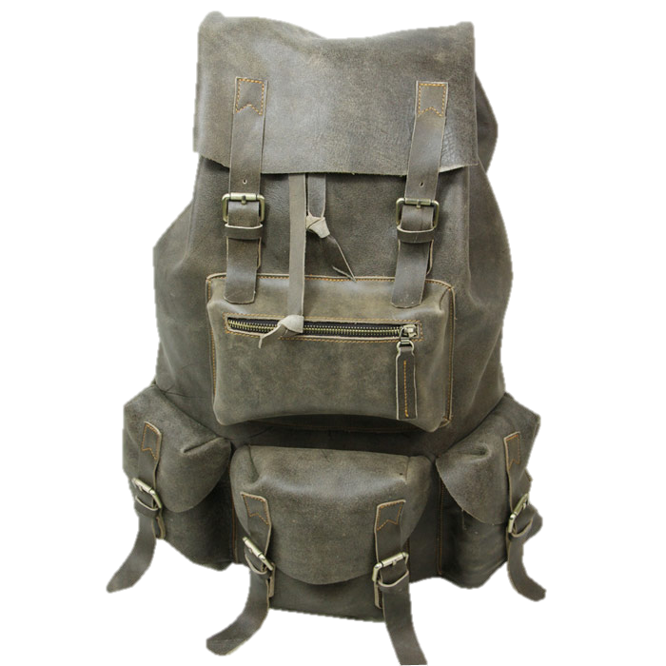
Virtual Backpack
Your are planning your dream vacation to Europe with your buds. You and your friends decided to do the cool thing and backpack though Europe.
Property of
____________________________
Notes:
Make your you label your backpack!

Slide 3
Time to Pack!
Its time to start preparing for your backpacking adventure. Choose two pieces of clothing that with keep you comfy in your countries during this time of year. Place them in the boxes to the right with a short rationale.
Rationale: _________________________________
__________________________________________
Rationale: _________________________________
__________________________________________

Slide 4
Travel Dictionary
English Word/Phrase | Language(s) | Word/Phrase in foreign language
Hello
How are you?
Please.
Thank you.
Excuse Me.
You choose
You choose
You choose
You choose
Notes:
You will need a pocket dictionary for your travels to interact with the locals. Fill in your dictionary with common words and phrases you will need to know then add three of your own!

Slide 5
Currency: Its hard to get those goodies without knowing the local currency. Choose one of the countries in your region and place a picture(s) of its currency in the box.
Now, choose two parts of your currency and explain its cultural/historical importance to your country. Complete sentences please!
____________________________________________________________________________________________________________________________________________________________________________________________________________________________________________________________________________________

Slide 6
You will now plan the next 6 days of your trip. Figure out where you will go and what you will do there. Follow the directions for the Journal Entries.
Your name’s
Daily Journal
Day 1: Location: _______________________
Today you will visit a major religious site in the city.
What site did you visit?
_______________________
Journal Entry: Write a two sentence description of the site here.
Take a picture of the religious site and place in the box above.

Slide 7
Day 2: Location:
_____________________
Day 2
Today you will visit a major arena. (Sports or arts)
What site did you visit?
_______________________
Journal Entry: Describe the architecture of the stadium in contrast to those in the U.S.
Collect a post card of the team or take a picture from a seat inside

Slide 8
Day 3: Location:
_____________________
Day 3
Today you will visit a local museum.
_______________________
Journal Entry: Describe the importance of the artifact or artwork in the picture to the right.
Take a picture of the most famous artifact or artwork in the museum.

Slide 9
Day 4: Location:
_____________________
Day 4
Today you will visit a local war memorial or battle site.
_______________________
Journal Entry: Describe the major battle that was fought there.
Take a picture near a monument or of the landscape.

Slide 10
Day 5: Location:
_____________________
Day 5
Today you will visit any site you would like!
_______________________
Journal Entry: Describe the site you go to!
Take a picture at the site.

Slide 11
Day 6: Location:
_____________________
Day 6
Today you will visit any site you would like!
_______________________
Journal Entry: Describe the site you go to!
Take a picture at the site.

Slide 12
Restaurant Name
Appetizers:
Main Dishes:
Soups/Salads:
Picture
Picture
Picture
Picture
Desserts:
Drinks:
Notes:
Throughout your travels, you tried many different foods. This is a restaurant menu you took from one of the restaurants you went to. Create a menu based on the local foods in your region. EACH FOOD SHOULD BE LISTED WITH A DESCRIPTION AND A PRICE. Give the restaurant a name and add some pictures of the foods. Feel free to change the design of your menu! NO COPYING!

Slide 13
Front of Postcard:
Place photo and greeting here.
Notes:
Front of the Postcard Directions:
This is the front of the postcard. It must represent a prominent physical feature of one of the places you went to on your trip. It must include the following:
A photograph (or collage of photographs) of the physical feature you are highlighting
A greeting in the language that is spoken in the country.
The name of the physical feature.

Slide 14
Dear….
Place stamp here
Place name and address of person you are sending this postcard to here:
____________________________________________________________________________________________________________________________________________
Notes:
Write a note home to a friend/family/Justin Bieber describing in detail the physical feature you went visited. Your note needs to be at least two paragraphs and needs to answer the following NO COPYING FROM THE INTERNET!:
Describe the physical feature in detail.
What is the historical significance of the physical feature?
What is the physical feature most similar to back home?
What is unique about this physical feature?
How does the physical feature make you feel?

Slide 15
Souvenirs
What are you going to add to your backpack to make your backpack stand out!?

Slide 16
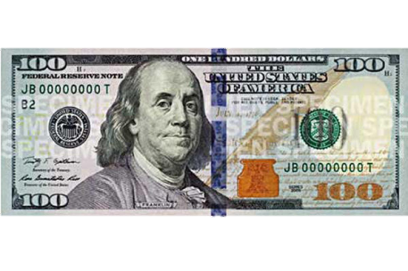
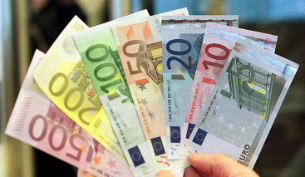
Total Cost of Your Trip
How much did it cost to stay in Hotel’s/Hostels?
How much for souvenirs?
How much for the Extra fun?!? (Sites, Tours, History?)
How much did it cost for transportation? (Flights to and from Europe)
How much for food?
What was the total cost of your European backpacking adventure?
Notes:
*Honors Only*
Put items in spreadsheet (given to you)
Find prices of items
Calculate US Dollar to Euro
Put the itemized list in your backpack (category totals and GRAND TOTAL)
Turn in completed spreadsheet

