Slide 1
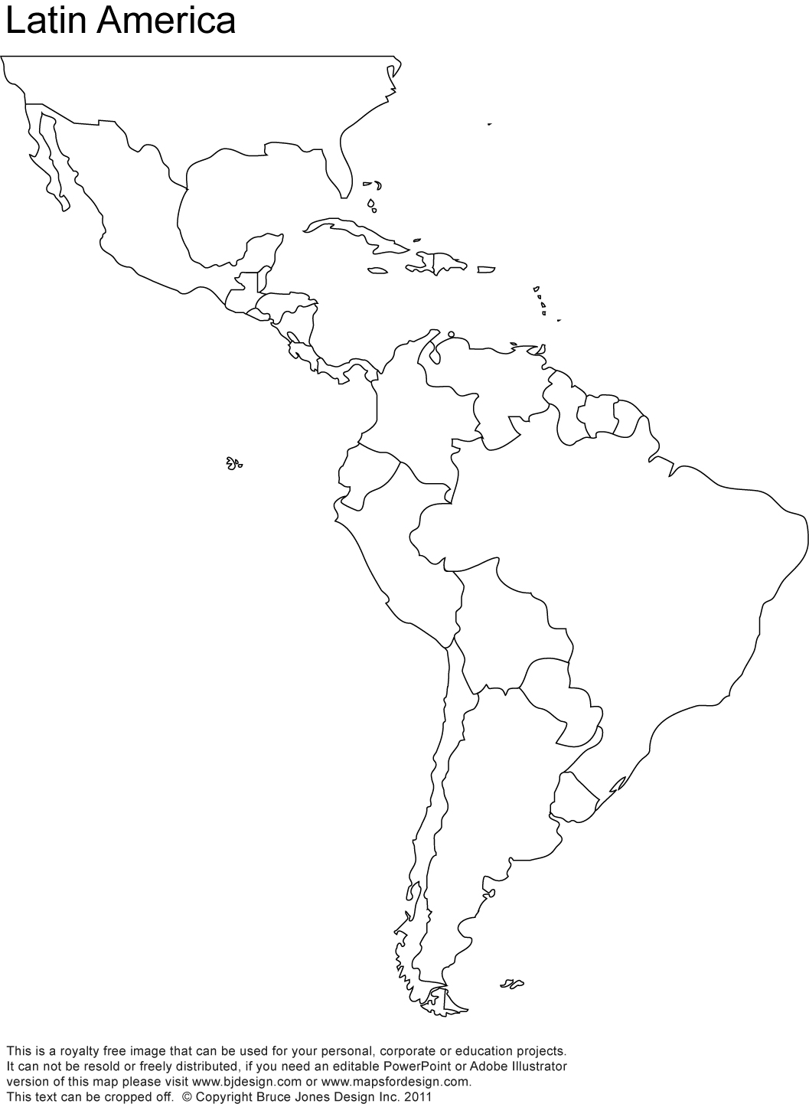
Name: _______________________________ Date: __________________ Period: ______
Latin America Political Map

Slide 2
Latin America Physical Map

